Slide 1

CUI Abbottabad
Department of Computer Science
Object Oriented Programming
Lecture No. 6 & 7
Classes, Objects and Methods
COMSATS University Islamabad, Abbottabad Campus

Slide 2
OO Programming Concepts
Object-oriented programming (OOP) involves programming using objects. An object represents an entity in the real world that can be distinctly identified. For example, a student, a desk, a circle, a text box, a button, a Laptop can all be viewed as objects. An object has a unique identity, state, and behaviors. The state of an object consists of a set of data fields (also known as properties) with their current values. The behavior of an object is defined by a set of methods.

Slide 3
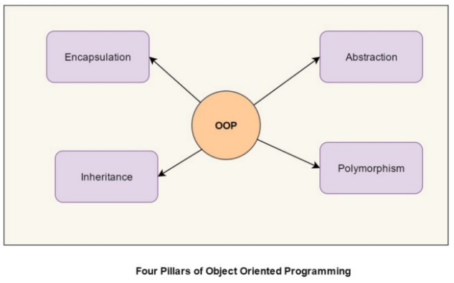
Basic OO Programming Principles

Slide 4
Basic OO Programming Principles
Encapsulation
Encapsulation is the mechanism of hiding of data implementation by restricting access to public methods. Instance variables are kept private and accessor methods are made public to achieve this.
Polymorphism
It means one interface, with multiple methods. It is further of two types — static and dynamic. Static polymorphism is achieved using method overloading and dynamic polymorphism using method overriding. It is closely related to inheritance. We can write a code that works on the superclass, and it will work with any subclass type as well.

Slide 5
Basic OO Programming Principles
Inheritance
Inheritances expresses “is-a” and/or “has-a” relationship between two objects. Using Inheritance, In derived classes we can reuse the code of existing super classes.
Abstraction
Abstract means a concept or an Idea which is not associated with any particular instance. Using abstract class/Interface we express the intent of the class rather than the actual implementation. In a way, one class should not know the inner details of another in order to use it, just knowing the interfaces should be good enough.

Slide 6
Classes
Classes are logical constructs that define objects of the same type. A Java class uses variables to define data fields and methods to define behaviors. Additionally, a class provides a special type of methods, known as constructors, which are invoked to construct objects from the class.
A class is a user defined prototype from which objects are created. It represents the set of properties or methods that are common to all objects of one type.

Slide 7

Objects
An object has the physical reality which contain (both a state and behavior).
State: It is represented by attributes of an object. It also shows properties of an object.
Behavior: It is represented by methods of an object. It shows response of an object with other objects.
Identity: It gives a unique name to an object. It also grants permission to one object to interact with other objects.

Slide 8
General form of Class
class classname {
type instance-variable1;
type instance-variable2;
// ...
classname(){ //constructor a special method
}
type methodname1(parameter-list) {
// body of method
}
type methodname2(parameter-list) {
// body of method
}
}//end of class

Slide 9
A simple Class
Here is a class called Box that defines three instance variables: width, height, and depth. Currently, Box does not contain any methods.
class Box {
double width;
double height;
double depth;
}
Box mybox;
mybox = new Box(); // create a Box object called mybox
OR
Box mybox = new Box();

Slide 10
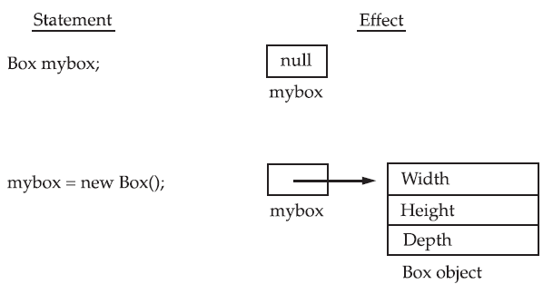
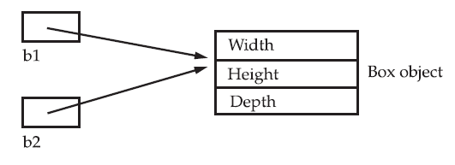
Adding Object reference variable
Box b1 = new Box();
Box b2 = b1;

Slide 11
Example:
class Box {
double width;
double height;
double depth;
}
// This class declares an object of type Box.
class BoxDemo {
public static void main(String args[]) {
Box mybox = new Box();
double vol;
// assign values to mybox's instance variables
mybox.width = 10;
mybox.height = 20;
mybox.depth = 15;
// compute volume of box
vol = mybox.width * mybox.height * mybox.depth;
System.out.println("Volume is " + vol);
}
}

Slide 12
A simple Class with Method and Object
class Test{
void showMsg(){
System.out.print(“Hello World...”);
}//end of Method
}//end of class
class Demo{
public static void main(String[] a){
Test ob = new Test();
//Objects are dynamically allocated
ob.showMsg();
}//main end
}

Slide 13
Initialization through method
class Box {
double width,height,depth,vol;
void compute_volume(double w, double h, double d){
width = w;
height = h;
depth = d;
vol = width * height * depth;
}
void show_vol(){
System.out.print(“Volume is...” + vol);
}
}
// This class declares an object of type Box.
class BoxDemo {
public static void main(String args[]) {
Box ob = new Box();
Ob.compute_vol(30,20,40);
Ob.show_vol();
} }

Slide 14
Example: Returning a value
class Box {
//class attributes
void setDim(double w, double h, double d) {
width = w; // sets dimensions of box
height = h;
depth = d;
}
double volume() { // compute and return volume
return width * height * depth;
} }
//Main Program
Box mybox = new Box();
mybox.setDim(10, 20, 15);
double vol = mybox.volume();
System.out.println("Volume is " + vol);

Slide 15
Example:
class A{
int x,y;
void get(int a, int b){
x=a; y=b;
}
void show(){
System.out.println(x+"\t"+y);
}
}//class end
//Main Program
A ob1=new A(); A ob2=new A();
ob1.get(5,6); ob1.show();
ob2 = ob1; ob2.show();
ob2.x=15; ob2.y=20;
ob1.show(); ob2.show();
ob1 = null; ob2.show();

Slide 16
CONSTRUCTOR
A constructor initializes an object immediately upon creation.
It has the same name as the class in which it resides.
A special method with NO return type even void.
Once defined, the constructor is automatically called immediately after the object is created.

Slide 17
Constructor cont.
/* Here, Box uses a constructor to initialize the
dimensions of a box.*/
class Box {
double width;
double height;
double depth;
// This is the constructor for Box.
Box() {
System.out.println("Constructing Box");
width = 10;
height = 10;
depth = 10;
}

Slide 18
Example: Constructor Demo
class Test{
int value1,value2;
Test(){ //constructor
value1 = 10;
value2 = 20;
System.out.println("Inside Constructor");
}
public void display(){
System.out.println("Value1 = "+value1);
System.out.println("Value2 = "+value2);
}
}
Class Demo{
public static void main(String args[]){
Test ob = new Test();
ob.display(); }
}

Slide 19
Parameterized Constructors
/* Here, Box uses a parameterized constructor to
initialize the dimensions of a box.*/
class Box {
double width;
double height;
double depth;
Box(double w, double h, double d) {
width = w;
height = h;
depth = d;
}
//Main...
Box ob1 = new Box(10,20,15); //object ob1
Box ob2 = new Box(3,6,9); //object ob2

Slide 20
Example: Use of the parameterized constructor.
class Student{
int id;
String name;
//creating a parameterized constructor
Student(int i, String n){
id = i;
name = n;
}
//method to display the values
void display(){System.out.println(id+" "+name);}
}//
//Main. . .
Student s1 = new Student(99,“Muhammad Umar");
Student s2 = new Student(85,“Adil Khan");
//calling method to display the values of object
s1.display();
s2.display();

Slide 21
class A{
int x, y;
A(int a, int b){
x = a; y = b;
}
void update(int a, int b){
x = a; y = b;
}
void show(){
System.out.println(x+”\t”+y);
}
//main...
A ob = new A(5,6);
ob.show();
ob.update(1,2);
ob.show(); //outcome ???

Slide 22
Use of this Keyword
class A{
int x, y;
A(int x, int y){
this.x = x;
this.y = y;
System.out.println("Inside Constructor");
}
}
public void display(){
System.out.println("X = "+x);
System.out.println("Y = "+y); }
//main...
A ob = new A(5,6);
ob.display();
//Demonstrate the use of this keyword

Slide 23
Constructor Overloading
Constructor overloading is a technique of having more than one constructor with different parameter lists.
They are arranged in a way that each constructor performs a different task.
They are differentiated by the compiler by the number of parameters in the list and their types.
A valid example of constructor overloading
Test(int a);
Test(int a, int b);
Test(String a, int b);

Slide 24
class Demo{
int id;
String name;
int marks;
Demo(){
System.out.println(“Without Parameter constructor”);
}
Demo(int a, String n){
id = a;
name = n;
}
Demo(int a, String n, int m){
id = a;
name = n;
marks = m;
}
//main
Demo ob1 = new Demo();
Demo ob2 = new Demo(99,”Muhammad Umar”);
Demo ob3 = new Demo(99,”Adil”,97);

Slide 25
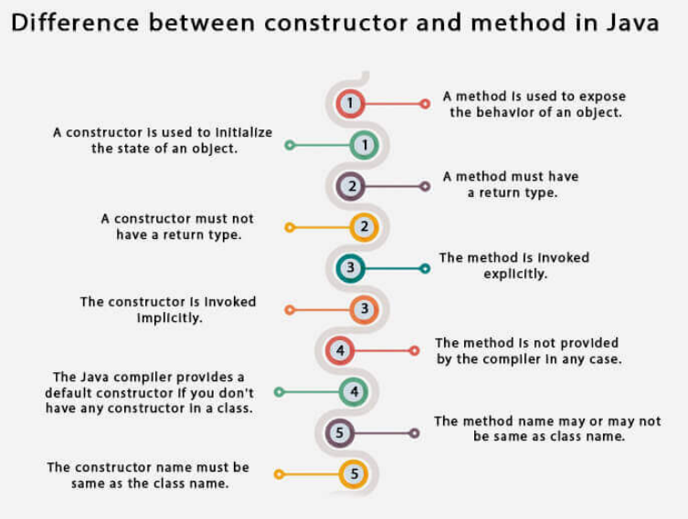

Slide 26
A Closer Look at Methods and Classes
Overloading Methods
One Interface multiple methods
In Java it is possible to define two or more methods within the same class that share the same name, as long as their parameter declarations are different.
When this is the case, the methods are said to be overloaded, and the process is referred as method overloading.
There are two ways to overload the method in java
By changing number of arguments
By changing the data type

Slide 27
// Demonstrate method overloading.
class Demo {
void test() {
System.out.println("No parameters");
}
// Overload test for one integer parameter.
void test(int a) {
System.out.println("a: " + a);
}
// Overload test for two integer parameters.
void test(int a, int b) {
System.out.println("a and b: " + a + " " + b);
}
// overload test for a double parameter
double test(double a) {
System.out.println("double a: " + a);
return a*a;
}
}

Slide 28
//main. . .
class Overload {
public static void main(String args[]) {
Demo ob = new Demo();
double result;
// call all versions of test()
ob.test();
ob.test(99);
ob.test(50, 90);
result = ob.test(99.9);
System.out.println("Result of ob.test(99.9): " + result);
}
}

Slide 29
class A{
int sum(int x, int y) {
return (x + y);
}
int sum(int x, int y, int z) {
return (x + y + z);
}
double sum(double a, double b) {
return (a + b);
}
}
// Driver code
A ob = new A();
System.out.println(ob.sum(10, 20));
System.out.println(ob.sum(10, 20, 30));
System.out.println(ob.sum(10.5, 20.5));

Slide 30
Valid/invalid cases of method overloading
Case 1:
int mymethod(int a, int b, float c)
int mymethod(int var1, int var2, float var3)
Case 2:
int mymethod(int a, int b)
int mymethod(float var1, float var2)
Case 3:
int mymethod(int a, int b)
int mymethod(int num)
Case 4:
float mymethod(int a, float b)
float mymethod(float var1, int var2)

Slide 31
Using Objects as Parameters
Example 1: Objects passed to a method
class test {
int a,b;
test(int a, int b) {
this.a = a;
this.b = b;
}
void call(test temp) {
temp.a *= 2;
temp.b /= 2;
}
}
//Main. . .
test ob = new test(10, 20);
ob.call(ob);
System.out.println(ob.a + " " + ob.b);

Slide 32
Example 2: Returning of Object
class A{
int x,y;
void get(int a, int b){
x=a; y=b;
}
A update(A temp){ //object returning
temp.x=10; temp.y=20;
return temp;
}
void show(){
System.out.println(x+ "\t“ +y);
}}
//Main . . .
A ob1=new A(); A ob2=new A();
ob1.get(5,6); ob1.show();
ob1=ob1.update(ob2);
ob1.show(); ob2.show();

